Slide 1
18CSC301T – FORMAL LANGUAGE AND AUTOMATA
UNIT-IV

Slide 2
Turing Machines

Slide 3
Introduction
TM’s described in 1936
Well before the days of modern computers but remains a popular model for what is possible to compute on today’s systems
Advances in computing still fall under the TM model, so even if they may run faster, they are still subject to the same limitations
A TM consists of a finite control (i.e. a finite state automaton) that is connected to an infinite tape.

Slide 4
Turing Machine
The tape consists of cells where each cell holds a symbol from the tape alphabet. Initially the input consists of a finite-length string of symbols and is placed on the tape. To the left of the input and to the right of the input, extending to infinity, are placed blanks. The tape head is initially positioned at the leftmost cell holding the input.
Finite control
… B B X₁ X₂ … X_{i} X_{n} B B …

Slide 5
Turing Machine Details
In one move the TM will:
Change state, which may be the same as the current state
Write a tape symbol in the current cell, which may be the same as the current symbol
Move the tape head left or right one cell
Formally, the Turing Machine is denoted by the 7-tuple:
M = (Q, ∑, Γ, δ, q₀, B, F)

Slide 6
Turing Machine Description
Q = finite states of the control
∑ = finite set of input symbols, which is a subset of Γ below
Γ = finite set of tape symbols
δ = transition function. δ(q,X) are a state and tape symbol X.
The output is the triple, (p, Y, D)
Where p = next state, Y = new symbol written on the tape, D = direction to move the tape head
q₀= start state for finite control
B = blank symbol. This symbol is in Γ but not in ∑.
F= set of final or accepting states of Q.

Slide 7
Instantaneous Description
Sometimes it is useful to describe what a TM does in terms of its ID (instantaneous description), just as we did with the PDA.
The ID shows all non-blank cells in the tape, pointer to the cell the head is over with the name of the current state
use the turnstile symbol ├ to denote the move.
As before, to denote zero or many moves, we can use ├*.

Slide 8
A Turing Machine
Tape
...... |  |  |  |  |  |  |  |  |  | ......
Read-Write head
Control Unit

Slide 9
The Tape
No boundaries -- infinite length
...... |  |  |  |  |  |  |  |  |  | ......
Read-Write head
The head moves Left or Right

Slide 10
Read-Write head
...... |  |  |  |  |  |  |  |  |  | ......
The head at each time step:
Reads a symbol
Writes a symbol
Moves Left or Right

Slide 11
Example:
Time 0
...... |  |  | a | b | a | c |  |  |  | ......
Time 1
Reads a
Writes k
Moves Left
...... |  |  | a | b | k | c |  |  |  | ......

Slide 12
Time 1
...... |  |  | a | b | k | c |  |  |  | ......
Time 2
...... |  |  | a | f | k | c |  |  |  | ......
Reads b
Writes
f
3. Moves Right

Slide 13


The Input String
Input string
Blank symbol
...... |  |  | a | b | a | c |  |  |  | ......
head
Head starts at the leftmost position of the input string
Are treated as left and right brackets for the input written on the tape.

Slide 14
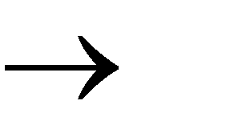
States & Transitions
Write
Read
Move Left
a b, L
q₁
q₂
Move Right
a b, R
q₁
q₂

Slide 15
Example:
Time 1
q₁
current state
...... |  |  | a | b | a | c |  |  |  | ......
a b, R
q₁
q₂

Slide 16
Time 1
q₁
Time 2
q₂
...... |  |  | a | b | a | c |  |  |  | ......
...... |  |  | a | b | b | c |  |  |  | ......
a b, R
q₁
q₂

Slide 17
Example:
Time 1
q₁
Time 2
...... |  |  | a | b | a | c |  |  |  | ......
...... |  |  | a | b | b | c |  |  |  | ......
q₂
q₂
a b, L
q₁

Slide 18

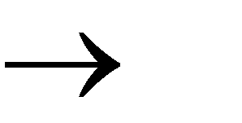
Example:
Time 1
q₁
Time 2
q₂
...... |  |  | a | b | a | c |  |  |  | ......
...... |  |  | a | b | b | c | g |  |  | ......
g, R
q₁
q₂

Slide 19
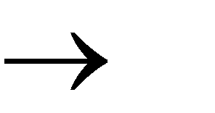
Determinism
Turing Machines are deterministic
Allowed
a b, R
Not Allowed
a b, R
q₂
q₂
q₁
q₁
q₃
q₃
b d, L
a d, L

Slide 20
Partial Transition Function
Example:
...... |  |  | a | b | a | c |  |  |  | ......
q₁
a b, R
q₂
Allowed:
No transition
for input symbol c
q₁
q₃
b d, L

Slide 21
Halting
The machine halts if there are no possible transitions to follow

Slide 22
Example:
...... |  |  | a | b | a | c |  |  |  | ......
q₁
a b, R
q₂
No possible transition
HALT!!!
q₁
q₃
b d, L

Slide 23
Final States
q₁
q₂
Allowed
q₁
q₂
Not Allowed
Final states have no outgoing transitions
In a final state the machine halts

Slide 24
Turing Machines as Acceptors
A Turing machine halts when it no longer has any available moves. If it halts in a final state, it accepts its input; otherwise, it rejects its input.

Slide 25
Turing Machines as Acceptors
We said a Turing machine accepts its input if it halts in a final state. There are two ways this could fail to happen:
The Turing machine could halt in a nonfinal state, or The Turing machine could never stop (in which case we say it is in an infinite loop. )
If a Turing machine halts, the sequence of configurations leading to the halt state is called a computation.

Slide 26
Acceptance
If machine halts
in a final state
Accept Input
If machine halts
in a non-final state
or
If machine enters an infinite loop
Reject Input

Slide 27
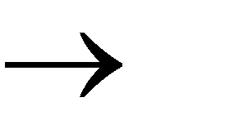

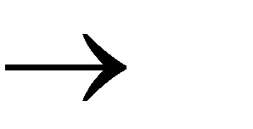
Turing Machine Example
A Turing machine that accepts the language:
aa *
a a, R
, L
q₀
q₁

Slide 28
Time 0
 |  |  | a | a | a
q₀
a a, R
, L
q₀
q₁

Slide 29
Time 1
 |  |  | a | a | a
q₀
a a, R
, L
q₀
q₁

Slide 30
Time 2
 |  |  | a | a | a
q₀
a a, R
, L
q₀
q₁

Slide 31
Time 3
 |  |  | a | a | a
q₀
a a, R
, L
q₀
q₁

Slide 32
Time 4
 |  |  | a | a | a
q₁
a a, R
Halt & Accept
, L
q₀
q₁

Slide 33
Rejection Example
Time 0
q₀
a a, R
 |  |  | a | b | a
, L
q₀
q₁

Slide 34
Time 1
 |  |  | a | b | a
q₀
No possible Transition
Halt & Reject
a a, R
, L
q₀
q₁

Slide 35
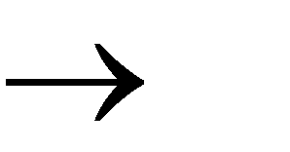
Infinite Loop Example
b b, L
a a, R
, L
q₀
q₁

Slide 36
Time 0
 |  |  | a | b | a
q₀
b b, L
a a, R
, L
q₀
q₁

Slide 37
Time 1
 |  |  | a | b | a
q₀
b b, L
a a, R
, L
q₀
q₁

Slide 38
Time 2
 |  |  | a | b | a
q₀
b b, L
a a, R
, L
q₀
q₁

Slide 39
Time 2
 |  |  | a | b | a
q₀
Time 3
 |  |  | a | b | a
q₀
Time 4
 |  |  | a | b | a
q₀
Time 5
a
b
a
q₀
... Infinite Loop

Slide 40
Because of the infinite loop:
The final state cannot be reached
The machine never halts
The input is not accepted

Slide 41
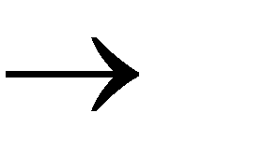
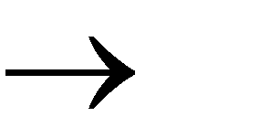
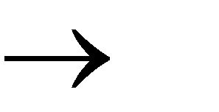
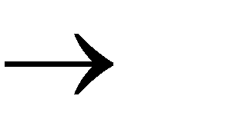
Another Turing Machine
Example
n n
Turing machine for the language
{a b }
y y, R
a a, R
y y, L
a a, L
q₄
y y, R
, L
y
y, R_{q0} a
x, R
b
y, L
q₃
q₁
q₂
x
x, R

Slide 42
aabb
Xabb
XaYb
XXYb
XXYY

Slide 43
Time 0
q₀
 |  | a | a | b | b
y y, R
a a, R
y y, L
a a, L
q₄
y y, R
, L
y
y, R_{q0} a
x, R
b
y, L
q₃
q₁
q₂
x
x, R

Slide 44
Time 1
 |  | x | a | b | b
q₁
y y, R
a a, R
y y, L
a a, L
q₄
y y, R
, L
y
y, R_{q0} a
x, R
b
y, L
q₃
q₁
q₂
x
x, R

Slide 45
Time 2
 |  | x | a | b | b
q₁
y y, R
a a, R
y y, L
a a, L
q₄
y y, R
, L
y
y, R_{q0} a
x, R
b
y, L
q₃
q₁
q₂
x
x, R

Slide 46
 |  | x | a | y | b
Time 3
q₂
y y, R
a a, R
y y, L
a a, L
q₄
y y, R
, L
y
y, R_{q0} a
x, R
b
y, L
q₃
q₁
q₂
x
x, R

Slide 47
Time 4
q₂
 |  | x | a | y | b
y y, R
a a, R
y y, L
a a, L
q₄
y y, R
, L
y
y, R_{q0} a
x, R
b
y, L
q₃
q₁
q₂
x
x, R

Slide 48
Time 5
q₀
 |  | x | a | y | b
y y, R
a a, R
y y, L
a a, L
q₄
y y, R
, L
y
y, R_{q0} a
x, R
b
y, L
q₃
q₁
q₂
x
x, R

Slide 49
Time 6
 |  | x | x | y | b
q₁
y y, R
a a, R
y y, L
a a, L
q₄
y y, R
, L
y
y, R_{q0} a
x, R
b
y, L
q₃
q₁
q₂
x
x, R

Slide 50
Time 7
 |  | x | x | y | b
q₁
y y, R
a a, R
y y, L
a a, L
q₄
y y, R
, L
y
y, R_{q0} a
x, R
b
y, L
q₃
q₁
q₂
x
x, R

Slide 51
Time 8
 |  | x | x | y | y
q₂
y y, R
a a, R
y y, L
a a, L
q₄
y y, R
, L
y
y, R_{q0} a
x, R
b
y, L
q₃
q₁
q₂
x
x, R

Slide 52
 |  | x | x | y | y
Time 9
q₂
y y, R
a a, R
y y, L
a a, L
q₄
y y, R
, L
y
y, R_{q0} a
x, R
b
y, L
q₃
q₁
q₂
x
x, R

Slide 53
Time 10
 |  | x | x | y | y
q₀
y y, R
a a, R
y y, L
a a, L
q₄
y y, R
, L
y
y, R_{q0} a
x, R
b
y, L
q₃
q₁
q₂
x
x, R

Slide 54
Time 11
 |  | x | x | y | y
q₃
y y, R
a a, R
y y, L
a a, L
q₄
y y, R
, L
y
y, R_{q0} a
x, R
b
y, L
q₃
q₁
q₂
x
x, R

Slide 55
Time 12
 |  | x | x | y | y
q₃
y y, R
a a, R
y y, L
a a, L
q₄
y y, R
, L
y
y, R_{q0} a
x, R
b
y, L
q₃
q₁
q₂
x
x, R

Slide 56
Time 13
 |  | x | x | y | y
q₄
Halt & Accept
y y, R
a a, R
y y, L
a a, L
q₄
y y, R
, L
y
y, R_{q0} a
x, R
b
y, L
q₃
q₁
q₂
x
x, R

Slide 57
Observation:
If we modify the machine for the language
{a^{n}b^{n}}
we can easily construct
a machine for the language
{a^{n}b^{n}c^{n}}

Slide 58
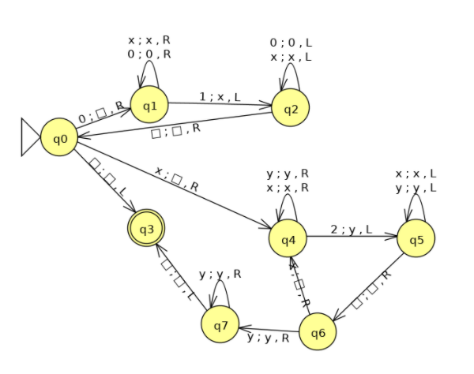
Turing Machines as Language Acceptors- Example 2
Design a TM to recognize the language of strings of the form 0^{n}1^{n}2^{n}

Slide 59
Construct a TM that accepts the palindrome of the string over the alphabets {a,b}
b | a | b | b | a | b | B

Slide 60
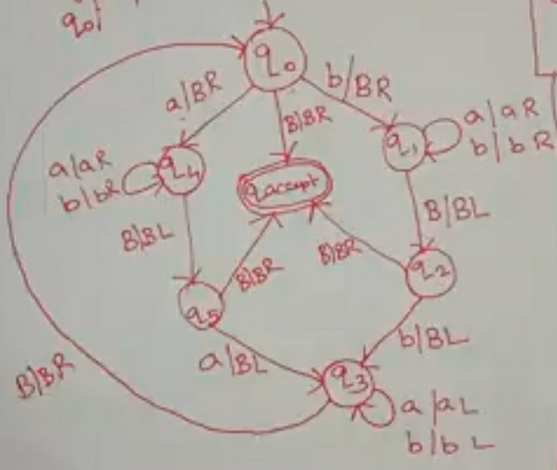

Slide 61
Computing Functions with Turing Machines

Slide 62
A function
has:
Domain:
Result Region:

Slide 63
A function may have many parameters:
Example:
Addition function

Slide 64
Integer Domain
Decimal:
5
Binary:
101
Unary:
11111
We prefer unary representation:
easier to manipulate with Turing machines

Slide 65
Definition:
A function is computable if
there is a Turing Machine such that:
Initial configuration
Final configuration
initial state
accept state
For all
Domain

Slide 66
In other words:
A function is computable if
there is a Turing Machine such that:
Initial
Configuration
Final
Configuration
Halts at
For all
Domain

Slide 67
Example
The function
is computable
are integers
Turing Machine:
Input string:
unary
Output string:
unary

Slide 68
Start
initial state
The 0 is the delimiter that
separates the two numbers

Slide 69
Start
initial state
Finish
final state

Slide 70
The 0 here helps when we use
the result for other operations
Finish
final state

Slide 71
Turing machine for function

Slide 72
Execution Example:
Time 0
(=2)
(=2)
Final Result

Slide 73
Time 0

Slide 74
Time 1

Slide 75
Time 2

Slide 76
Time 3

Slide 77
Time 4

Slide 78
Time 5

Slide 79
Time 6

Slide 80
Time 7

Slide 81
Time 8

Slide 82
Time 9

Slide 83
Time 10

Slide 84
Time 11

Slide 85
Time 12
HALT & accept

Slide 86
Another Example
The function
is computable
is integer
Turing Machine:
Input string:
unary
Output string:
unary

Slide 87
Start
initial state
Finish
accept state

Slide 88
Turing Machine Pseudocode for
Replace every 1 with $
Repeat:
Find rightmost $, replace it with 1
Go to right end, insert 1
Until no more $ remain

Slide 89
Turing Machine for

Slide 90
Example
Start
Finish

Slide 91
Back to binary!
How do we add two binary numbers on a Turing machine?
Instead of dealing with it directly, let us divide the problem into 2 parts
How to subtract 1 from a binary number
How to add 1 to a binary number
HW – think about how to do this without subroutines/functions/methods

Slide 92
How to add 1 to a binary number?
What is 11000 + 1 = ?
What is 10111 + 1 = ?
The pattern that emerges is …..

Slide 93
Multitape Turing Machines
A multitape Turing machine is like an ordinary TM but it has several tapes instead of one tape.
Initially the input starts on tape 1 and the other tapes are blank.
The transition function is changed to allow for reading, writing, and moving the heads on all the tapes simultaneously.
This means we could read on multiples tape and move in different directions on each tape as well as write a different symbol on each tape, all in one move.

Slide 94
Multitape Turing Machine
Theorem: A multitape TM is equivalent in power to an ordinary TM. Recall that two TM’s are equivalent if they recognize the same language. We can show how to convert a multitape TM, M, to a single tape TM, S:
Say that M has k tapes.
Create the TM S to simulate having k tapes by interleaving the information on each of the k tapes on its single tape
Use a new symbol # as a delimiter to separate the contents of each tape
S must also keep track of the location on each of the simulated heads
Write a type symbol with a * to mark the place where the head on the tape would be
The * symbols are new tape symbols that don’t exist with M
The finite control must have the proper logic to distinguish say, x* and x and realize both refer to the same thing, but one is the current tape symbol.

Slide 95
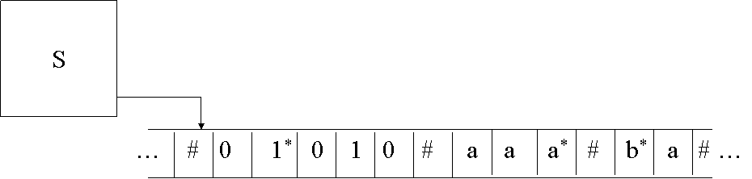
Multitape Machine
Equivalent Single Tape Machine:

Slide 96
Nondeterministic TM
Replace the “DFA” part of the TM with an “NFA”
Each time we make a nondeterministic move, you can think of this as a branch or “fork” to two simultaneously running machines. Each machine gets a copy of the entire tape. If any one of these machines ends up in an accepting state, then the input is accepted.
Although powerful, nondeterminism does not affect the power of the TM model
Theorem: Every nondeterministic TM has an equivalent deterministic TM.
We can prove this theorem by simulating any nondeterministic TM, N, with a deterministic TM, D.

Slide 97
Nondeterministic TM
Visualize N as a tree with branches whenever we fork off to two (or more) simultaneous machines.
Use D to try all possible branches of N, sequentially.
If D ever finds the accept state on one of these branches, then D accepts.
It is quite likely that D will never terminate in the event of a loop if there is no accepting state.
Search be done in a breadth-first rather than depth-first manner.
An individual branch may extend to infinity, and if we start down this branch then D will be stuck forever when some other branch may accept the input.
We can simulate N on D by a tape with a queue of ID’s and a scratch tape for temporary storage.
Each ID contains all the moves we have made from one state to the next, for one “branch” of the nondeterministic tree.
From the previous theorem, we can make as many multiple tapes as we like and this is still equivalent to a single tape machine. Initially, D looks like the following:

Slide 98
Nondeterministic TM
ID1 is the sequence of moves we make from the start state. The * indicates that this is the current ID we are executing.
We make a move on the TM. If this move results in a “fork” by following nondeterministic paths, then we create a new ID and copy it to the end of the queue using the scratch tape.
D
Scratch Tape
… ID1*
Queue of ID’s

Slide 99
Nondeterministic TM
For example, say that in ID1 we have two nondeterministic moves, resulting in ID2 and ID3:
D
Scratch Tape
… ID1* # ID2 # ID3

Slide 100
Nondeterministic TM
After we’re done with a single move in ID1, which may result in increasing the length of ID1 and storing it back to the tape, we move on to ID2:
D
Scratch Tape
… ID1 # ID2* # ID3

Slide 101
Nondeterministic TM
If any one of these states is accepting in an ID, then the machine quits and accepts.
If we ever reach the last ID, then we repeat back with the first ID.
Note that although the constructed deterministic TM is equivalent to accepting the same language as a nondeterministic TM, the deterministic TM might take exponentially more time than the nondeterministic TM.
It is unknown if this exponential slowdown is necessary. We’ll come back to this in the discussion of P vs. NP.
Theorem: Since any deterministic Turing Machine is also nondeterministic (there just happens to be no nondeterministic moves), there exists a nondeterministic TM for every deterministic TM.

Slide 102
Equivalence of TM’s and Computers
In one sense, a real computer has a finite amount of memory, and thus is weaker than a TM.
But, we can postulate an infinite supply of tapes, disks, or some peripheral storage device to simulate an infinite TM tape. Additionally, we can assume there is a human operator to mount disks, keep them stacked neatly on the sides of the computer, etc.
Need to show both directions, a TM can simulate a computer and that a computer can simulate a TM

Slide 103
THANK YOU!!!

